Slide 1
OO Design patterns IS4106-softwareArchitecture
Name –
Index No –

Slide 2
Introduction
Importance of design patterns in software engineering
Object-Oriented Design (OOD) is a methodology that focuses on creating software systems structured as a collection of interacting objects. Each object represents a real-world entity, encapsulating both data and behavior. Design patterns are established solutions to common design problems within OOD, offering reusable templates to streamline the development process.
Reusability: Promotes the reuse of solutions, reducing redundancy.
Efficiency: Saves time by providing tested solutions to recurring problems.
Maintainability: Enhances code modularity, making maintenance easier.
Scalability: Facilitates the growth and evolution of systems without major redesigns.
Communication: Creates a common vocabulary for developers, improving collaboration.

Slide 3
What are Design Patterns? Design patterns are reusable solutions to common problems encountered in software design. They provide a template for how to solve a problem in various contexts, promoting best practices and improving code quality. Design patterns are classified into three main categories:
1. Creational Patterns
2. Structural Patterns
3. Behavioral Patterns
Singleton
Factory Method
Abstract Factory
Builder
Prototype
Adapter
Composite
Decorator
Façade
Proxy
Flyweight
Observer
Strategy
Command
Iterator
Chain of Responsibility
State
Template Method

Slide 4
Creational Patterns Creational patterns focus on the process of object creation, providing techniques to instantiate objects in a flexible and reusable manner. They abstract the instantiation process, making a system independent of how its objects are created. Examples include singleton, factory method, abstract factory, builder, and prototype. These patterns help manage object creation, ensuring that the right objects are created for specific situations.
Singleton Pattern
The singleton pattern restricts the instantiation of a class to a single instance and ensures this instance is globally accessible. It provides a way to access the instance from anywhere within the application, typically using a static method.
Usage
When to Use:
When exactly one instance of a class is needed to coordinate actions across the system.
When the single instance should be accessible globally.
To control access to shared resources, such as database connections or configuration settings.

Slide 5
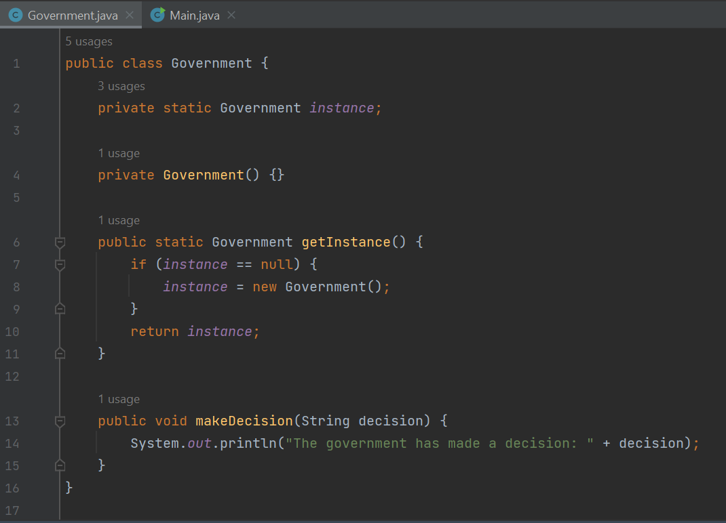
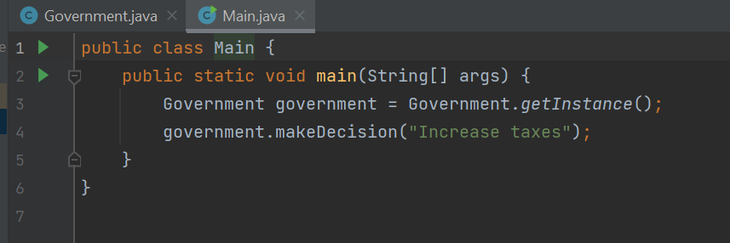
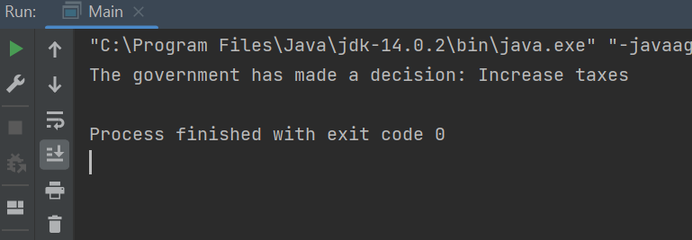
Example-:the government of a country. A country can have only one official government, and regardless of the personal identities of the individuals who form governments, the title "The Government of Sri Lanka" is a global point of access that identifies the group of people in charge.
output

Slide 6
Structural Patterns Structural patterns focus on how objects and classes are composed to form larger structures. They facilitate design by identifying a simple way to realize relationships between entities, ensuring that the system is organized in a flexible and efficient manner. These patterns help ensure that if one part of a system changes, the overall structure remains stable and easy to maintain.
Adapter Pattern
The adapter pattern allows incompatible interfaces to work together by converting the interface of a class into another interface that a client expects. It acts as a bridge between two incompatible interfaces, enabling them to collaborate without modifying their existing code.
USAGE
When to Use:
When you want to use an existing class but its interface does not match the one you need.
To create a reusable class that cooperates with unrelated or unforeseen classes.
To simplify integration of legacy systems with new ones.

Slide 7
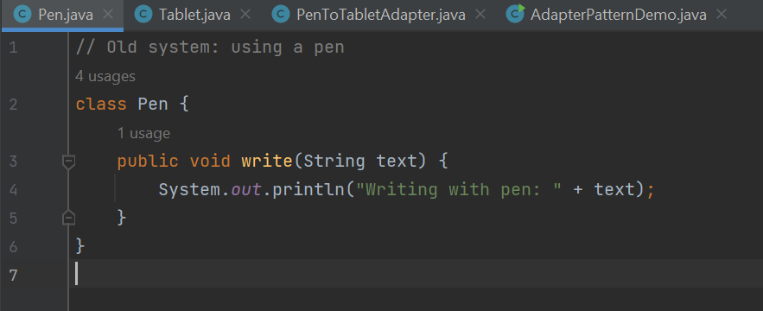
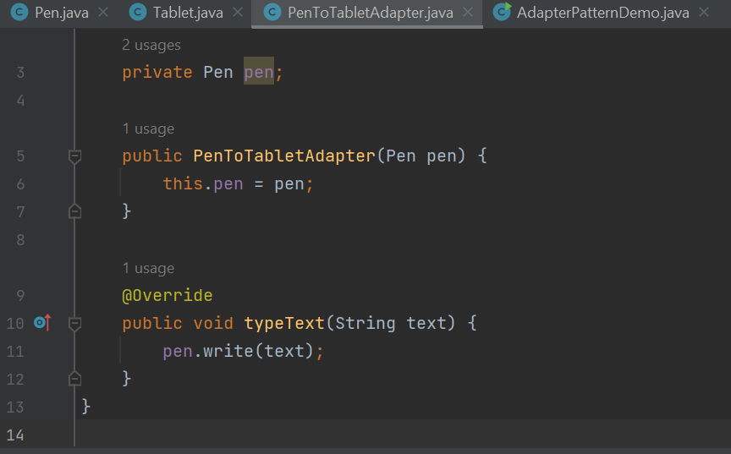
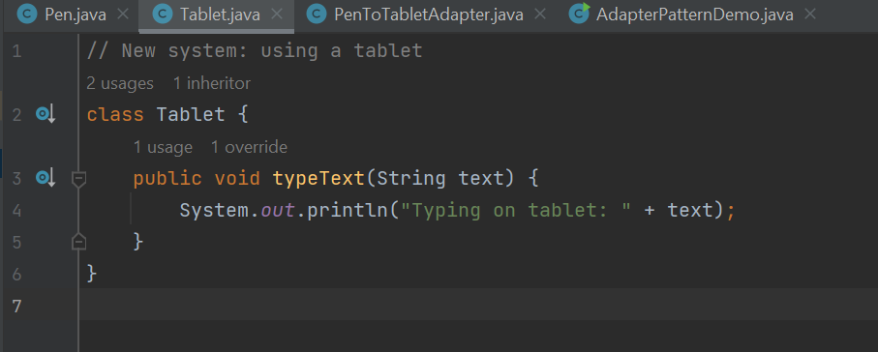
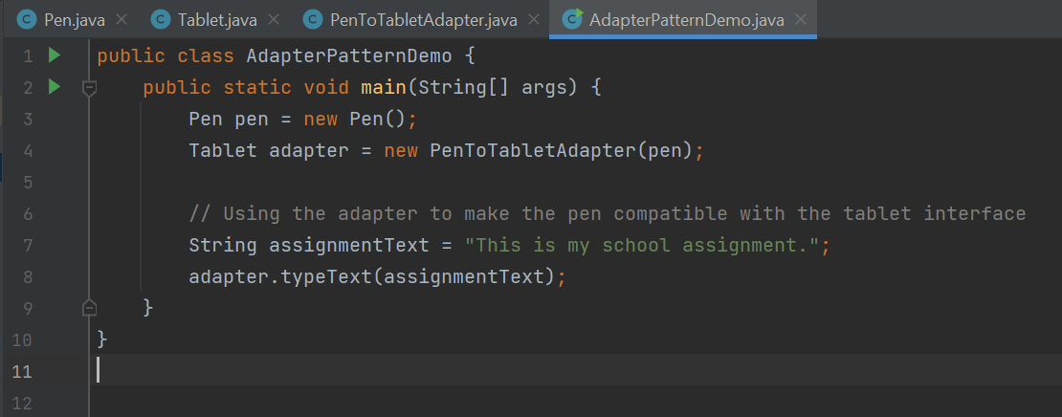
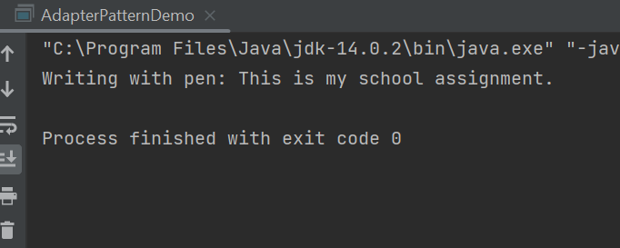
Example-:A student is doing an assignment in school using a pen, but the new system requires assignments to be done on a tablet. We'll use the Adapter pattern to make the old system (using a pen) compatible with
the new system (using a tablet).
Output-:

Slide 8
Behavioral Patterns Behavioral patterns focus on how objects interact and communicate with each other, defining the responsibilities and interactions between objects. These patterns help make the interactions between objects more flexible, understandable, and manageable by encapsulating behavior in objects, promoting loose coupling, and enhancing code maintainability.
Observer Pattern
The observer pattern defines a one-to-many dependency between objects, so that when one object (the subject) changes state, all its dependent objects (observers) are notified and updated automatically. This pattern is used to implement distributed event-handling systems, where a change in one object triggers updates to others.
usage
When to Use:
When changes in one object need to be reflected in multiple dependent objects without tight coupling.
To implement event handling systems where an event triggers multiple actions.
When an abstraction has two aspects, one dependent on the other, and you want to encapsulate these aspects in separate objects.

Slide 9
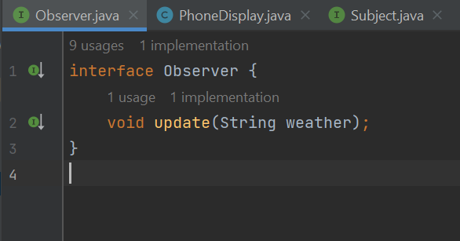
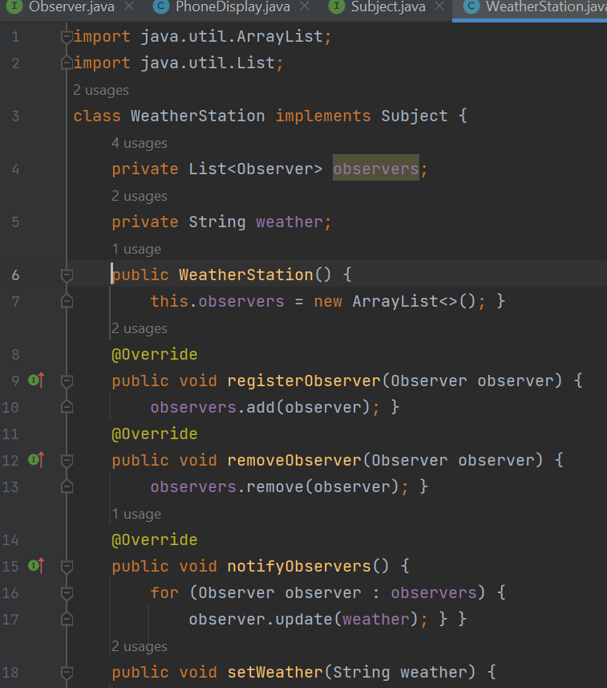
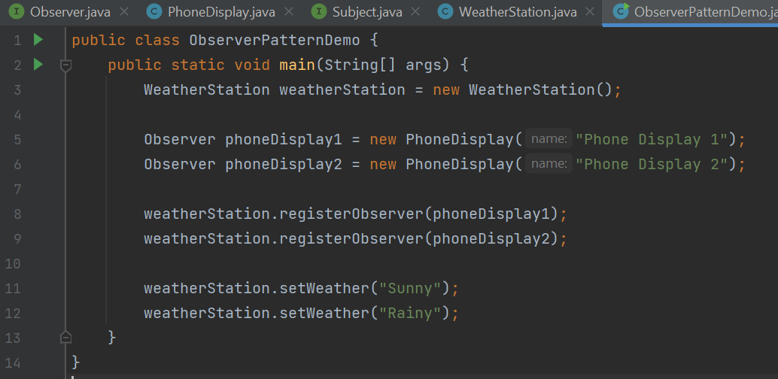
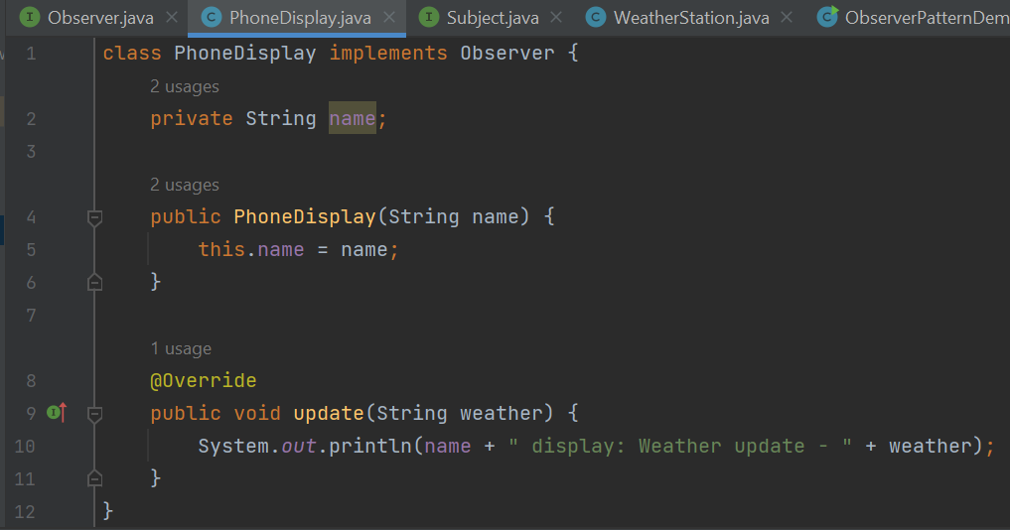
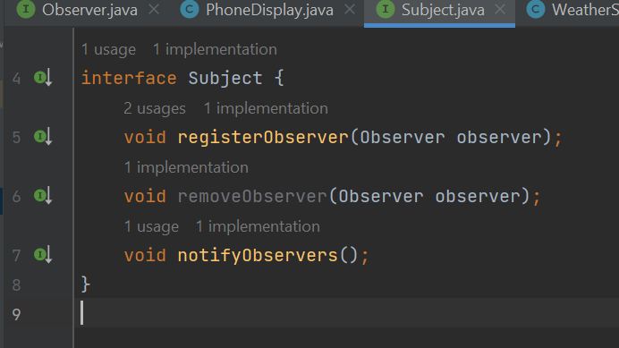
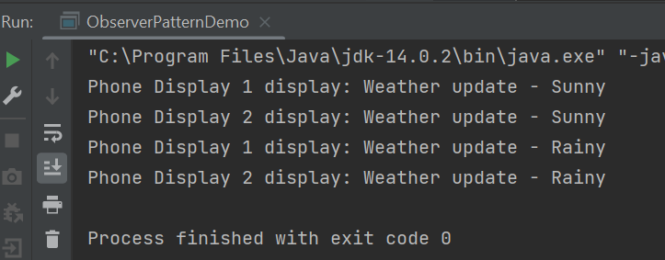
Example-: Consider a scenario where you have a weather station that provides weather updates. Multiple display devices subscribe to the weather station to receive updates whenever there's a change in the weather.
Output-:

Slide 10
THANK YOU !!!

